Slide 1
Adding New GitHub Repository
Adding your Project Files from VS Code to you GitHub Repo

Slide 2
Setting Up a New Capacitor Project with GitHub
Prerequisites
Install these first:
Node.js (v18+) — includes npm: https://nodejs.org
Git: https://git-scm.com
GitHub account: https://github.com

Slide 3
Configure Git (first time only on this PC)
git config --global user.name "Your Name"
git config --global user.email you@example.com
Use the same email as your GitHub account so commits are attributed correctly.

Slide 4
1. Prepare Your Project (Create .gitignore)
Before uploading, exclude heavy/generated folders. Create a .gitignore file in your project root:
# Dependencies
node_modules/
# Native build folders
android/.gradle/
android/app/build/
ios/App/Pods/
# OS & IDE files
.DS_Store
.vscode/

Slide 5
2. Initialize Git
git init
git add .
git commit -m "Initial commit: Capacitor project“
git status

Slide 6
3. Create a GitHub Repository
Create a GitHub Repository
Go to https://github.com/new
Repository name: my-capacitor-app
Visibility: Public or Private
Do NOT check "Add a README" / ".gitignore" / "license" (you already have files)
Click Create repository

Slide 7
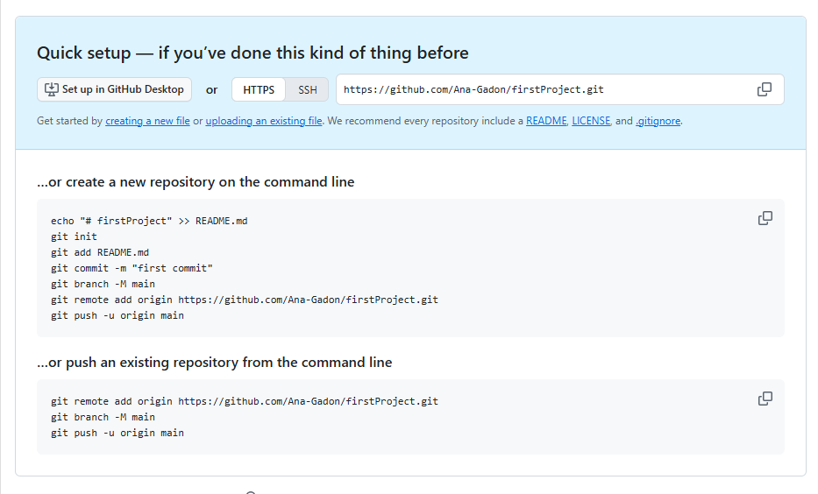
4. Connect Local Repo to GitHub & Push
Enumerating objects: 25, done.
Counting objects: 100% (25/25), done.
...
To https://github.com/Ana-Gadon/firstProject.git
* [new branch] main -> main
branch 'main' set up to track 'origin/main'.

Slide 8
4. Connect Local Repo to GitHub & Push
git remote add origin https://github.com/YOUR_USERNAME/my-capacitor-app.git
git branch -M main
git push -u origin main
If prompted for credentials, use a Personal Access Token (not your password):
GitHub → Settings → Developer settings → Personal access tokens → Tokens (classic) → Generate new token → check repo scope.

Slide 9
Then refresh https://github.com/Ana-Gadon/firstProject and your files will be there. ✅

Slide 10
5. Verify on GitHub
Refresh your repo page.
example: https://github.com/Ana-Gadon/firstProject and your files will be there.
You should see:
package.json, src/, public/
capacitor.config.json (or .ts)
android/ and ios/ folders
.gitignore
You should NOT see node_modules/ or dist/.

